Slide 1
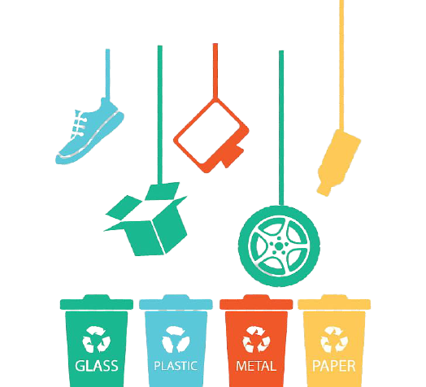
SOLID WASTE MANAGEMENT

Slide 2
Members
1.Abhijith Madhav M S, Roll No:4
2.Niranjan M S, Roll No:43
3.Vishnu Suresh, Roll No:60

Slide 3
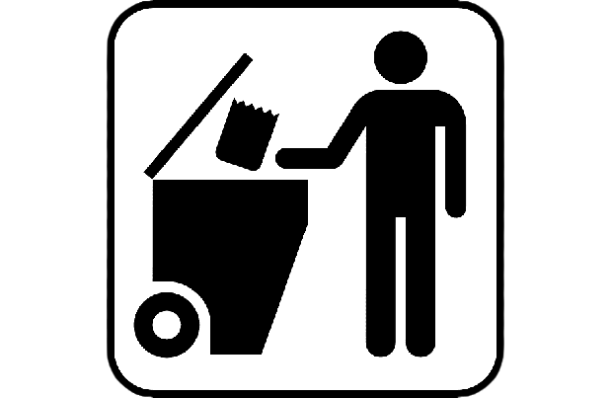
CONTENTS
1.Meaning of Solid Waste Management and It’s History
2.Categories of Waste and Various Sources Of Solid Waste
3.Solid Waste Generation,Storage,Collection,Treatment and disposal
4.Effects of Poor Solid Waste Management
5.Methods Of Solid Waste Management
6.Three R’s of Solid Waste Management
7.Solid Waste Management in India

Slide 4
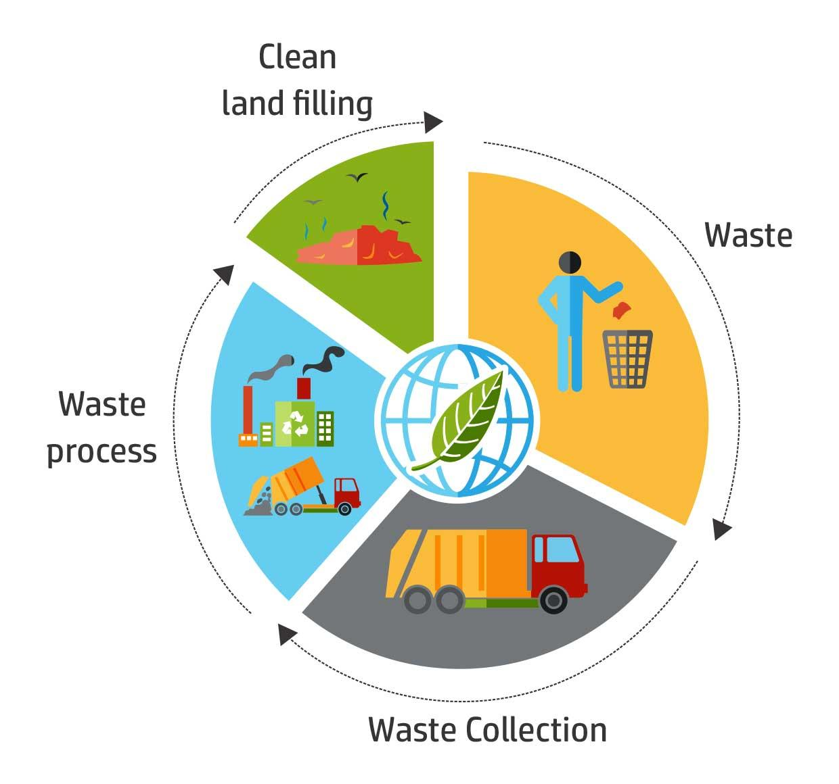
Solid-Waste Management means the collecting,treating and disposing of solid materials that is discarded because it has served its purpose or is no longer useful.
Introduction

Slide 5
HISTORY OF SOLID WASTE MANAGEMENT
In ancient cities,wastes were thrown onto,unpaved streets and roadways.
The First Known law about Waste Management was established on 320 B.C.E in Athens.
Advancements came in Waste Management towards the end of Eighteenth Century.
In America Municipal Collection of Garbage was begun.
An Advancement was made in 1894 in England.
First Incinerator was Established.
By beginning of the 20th century about 15 percent of major American Cities were using Incinerators.
By mid 20th centuries advancements like better garage cans, garage trucks etc was introduced.

Slide 6

CATEGORIES OF WASTE
1.Organic waste:Kitchen waste,Vegetable wastes etc..
2.Combustibles:paper,wood dried leaves etc..
3.Non-Combustibles:Metals,Tins,Cans etc..
4.Toxic Waste:Old Medicines,chemicals,batteries etc..
5.Recyclables:Paper,Glass etc..
6.Ashes or Dust:Residue from Fires
7.Construction waste:Broken Concrete,Roofing etc..
8.Hazardous Waste:Oil,Medical Waste etc..
9.Bulky Waste:Tree branches,tires etc..
10.E-Waste:Computer parts,Smartphone parts etc..
E-waste is the fastest growing waste in many developed countries.

Slide 7
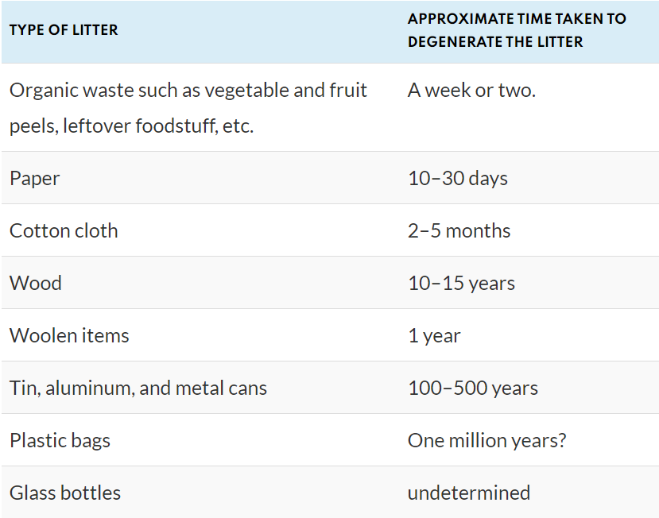
TIME TAKEN TO DEGENERATE DIFFERENT TYPES OF WASTE

Slide 8

VARIOUS SOURCES OF SOLID WASTE
1.Residential:Plastics,Food wastes etc..
2.Industrial:Packaging Waste,Construction Waste etc..
3.Commercial:metals,Paper,glass etc..
4.Agriculture:Spoiled crops,pesticide Containers etc..
5.Biomedical:Used medicinal supplies like bandage drugs and chemicals etc..

Slide 9
SOLID WASTE GENERATION,COLLECTION,TREATMENT AND DISPOSAL
In countries like United States the rate of solid waste generation is about 2kg per person per day.In India its about 0.5 kg per person per day.
Mainly the Solid waste is stored in closed containers(dumpsters)
It varies with use cases
From these containers it is collected using specialised trucks .
Then waste from several trucks get dumped into a single large truck which then carries it to the treatment area.
Treatment will be done to reduce the waste and makes it easier to handle.
It can also serve to recover some materials for recycling or reuse.

Slide 10
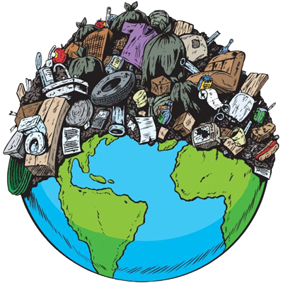
EFFECTS OF POOR WASTE MANAGEMENT
1. Litter Surroundings
2.Impact on Human Health
3.Disease causing Insects
4.Environmental Problems
5.Emission of toxic gases
6.Impact on Land and Aquatic animals

Slide 11
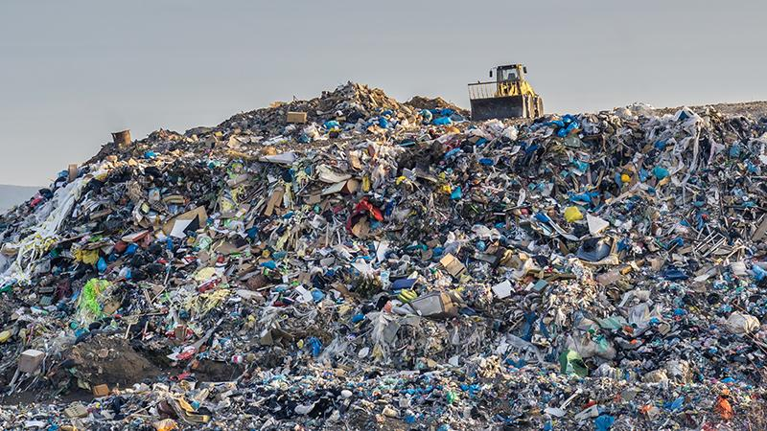
METHODS OF SOLID WASTE MANAGEMENT
1.Sanitary Landfill
It is the most traditional method of waste disposal
Waste is directly dumped into quarries,mining voids or simple empty lands
Disposed waste is covered with soil
Gases generated by decomposing waste materials are often burnt to generate power
It is generally used for domestic waste
Advantage:If landfills are managed efficiently,it is an ensured sanitary waste disposal method
Disadvantage:It requires a reasonably large area
2.Incineration
Incineration is a waste treatment process that involves the combustion of solid waste at 1000°C
Waste materials are converted into ash, flue gas and heat
The ash is mostly formed by the inorganic constituents of the waste and gases due to organic waste

Slide 12
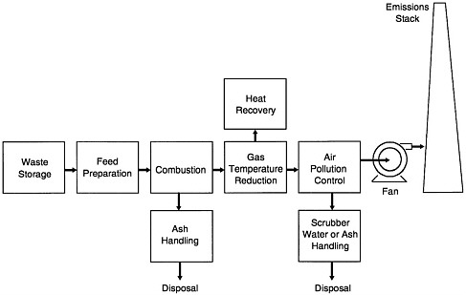
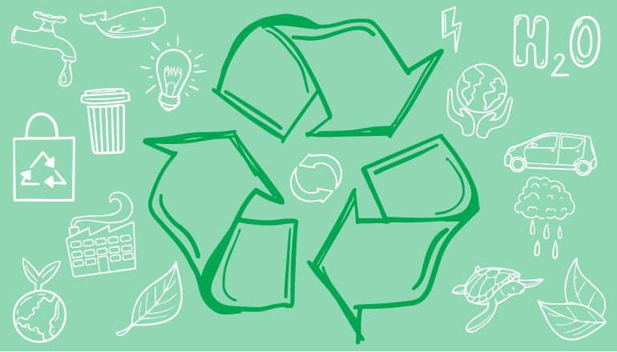
The heat generated by incineration is used to generate electric power
Advantage:The volume of combustible waste is reduced considerably by burning waste.
Disadvantage:It can cause smoke or fire hazard and also emits poisonous gases.
3.Recovery and Recycling
Recycling or recovery of resources is the process of taking useful but discarded items for the next use
This process aims at reducing energy loss, consumption of new material and reduction of landfills
Advantage:Recycling is environment friendly
Disadvantage:Expensive to set up and in some cases it has limited potential

Slide 13
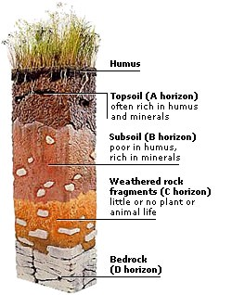
4.Composting
It is a process in which micro-organisms like fungi and bacteria converts degradable organic waste into substance like humus which is rich in carbon and nitrogen
Good quality environmentally friendly manure is formed from the compost that is an excellent medium for growing plants and can be used for agricultural purposes
Advantage:Environment friendly as well as beneficial for crops
Disadvantage:It requires intensive management and experienced personnel for large scale operation.

Slide 14
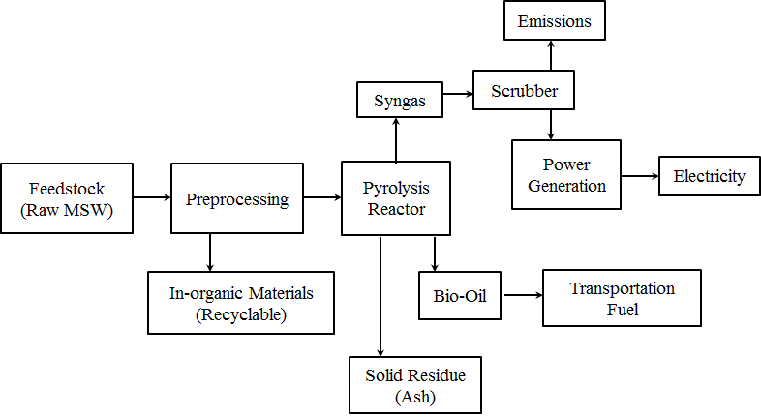
5.Pyrolysis
It is a method of solid waste management in which solid wastes are chemically decomposed by heat without the presence of oxygen
It usually occurs under pressure and at temperatures of up to 430 degrees Celsius
The solid wastes are changed into gases, solid residue of carbon and ash and small quantities of liquid
Advantage:This will keep the environment clean and reduce health and settlement problem.
Disadvantage:The systems that destroy chlorinated organic molecules by heat may create incomplete combustion products, including dioxins and furans. These compounds are highly toxic in the parts per trillion ranges. The residue it generates may be hazardous wastes, requiring proper treatment, storage, and disposal.

Slide 15
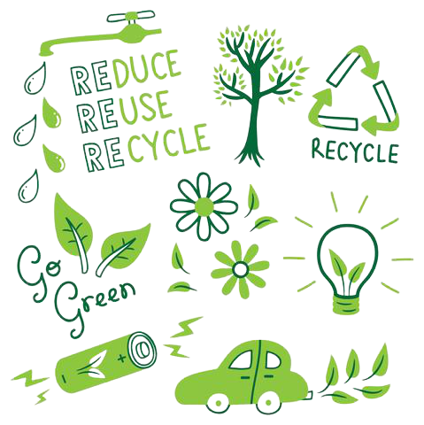
The 3 R’s Of Waste Management
1.Reduce
Say no to Plastic Bags, instead carry your own reusable bags when going to stores
Buy durable goods, these are more likely to last longer, reducing the need to replace them often
When Buying small items try to avoid bags if possible
Reduce the amount of printing you do and only print the documents that are important, where possible use PDF or other electronic formats
2.Reuse
Use Old clothes as cleaning clothes or donate them instead of throwing it away

Slide 16
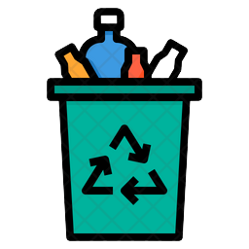
Try to repair Broken items instead of buying a new one
Reuse plastic bags for shopping instead of buying new ones
Use rechargeable batteries which can be reused again and again instead of regular ones
3.Recycle
Buy eco friendly products made up of recycled materials
Use recycled paper for printing and to make paper handicrafts
Avoid buying hazardous materials that could pose difficulty for you to recycle. Buy non-toxic products Whenever possible
Look for recycling symbol in products you buy
Use cloth bags which can be recycled easily instead of plastic bags

Slide 17
SOLID WASTE MANAGEMENT IN INDIA
Factors like population growth, development of megacities create a major problem of solid waste management.
Generally Indians have a lack of responsibility towards waste management.
Waste-to-Energy facilities is not very effective in India and need better Sanitary Landfills.
India faces challenges related to waste policy, waste technology selection and the availability of appropriately trained people in the waste management sector.
Until these fundamental requirements are met, India will continue to suffer from poor waste management and the associated impacts on public health and the environment.

Slide 18
CONCLUSION
SOLID WASTE MANAGEMENT IS ONE OF THE MOST WIDELY DISCUSSED TOPICS.
SOLID WASTE MANAGEMENT SHOULD BE DONE EFFECTIVELY TO AVOID PROBLEMS LIKE POLLUTION,INSECT BORNE DISEASES ETC..
PEOPLE’S ATTITUDE TOWARDS WASTE MANAGEMENT MUST CHANGE .
GOVERNMENTS OF COUNTRIES MUST FOCUS ON SOLID WASTE MANAGEMENT ON LARGE SCALE.
USEFUL TECHNOLOGICAL AND SCIENTIFIC ADVANCEMENTS SHOULD BE INVOLVED IN WASTE MANAGEMENT

Slide 19
SOURCES
1.https://www.conserve-energy-future.com/sources-effects-methods-of-solid-waste-management.php
2.https://www.britannica.com/technology/solid-waste-management/Recycling#ref72396
3.https://royalsocietypublishing.org/doi/10.1098/rsos.160764#d3e2555

Slide 20
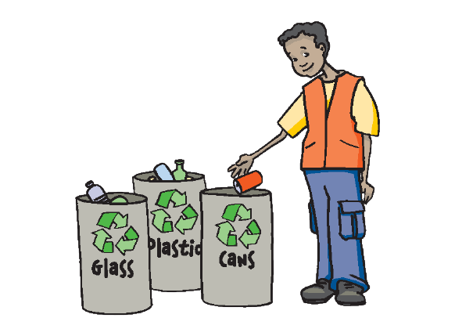
THANK YOU

